Slide 1
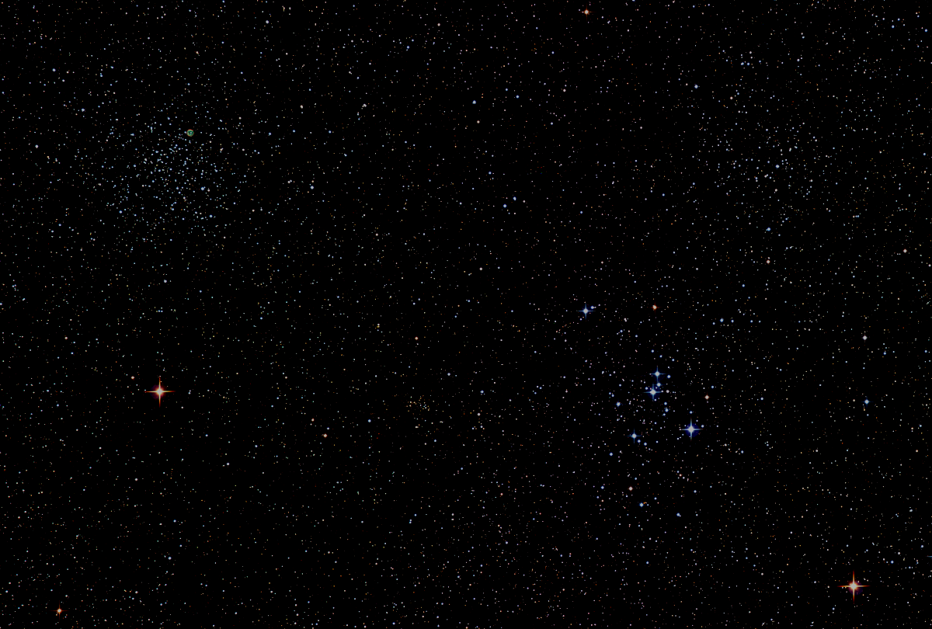

Howard
Astronomical
League
18
October 18th, 2018

Slide 2
Introductions

Slide 3
2019 HAL Elections
Coming up January 17, 2019
Working to identify an Elections Chair
All interested parties are encouraged to run for any office

Slide 4
Observatory Report
Director: Joel Goodman
Progress:
  Updated HALO Policies and Procedures
  Pointing issue resolved
  Tpoint precision alignment complete
Present:
  Resolving residual dome/scope synch issues
  Updating training materials
  Continuing to convert existing CTO/As
  Continuing to recruit aspiring new CTOs
Plan:
  Make observatory available to members via a CTA/CTO training track

Slide 5
Upcoming Events
HAL Events – Alpha Ridge Park
October 20th at 6:00 – Public Star Party
November 3rd at 6:00 – Members Star Party
November 10th at 4:45 – Public Star Party
Other Events
November 3rd-4th – Daylight Savings Time Ends

Slide 6
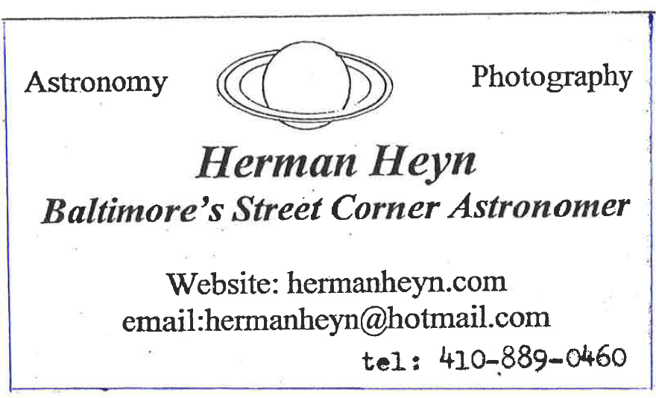
This Evening’s Speaker
My 73 Years in Astronomy

Slide 7
Member
Astrophotos and Sketches

Slide 8
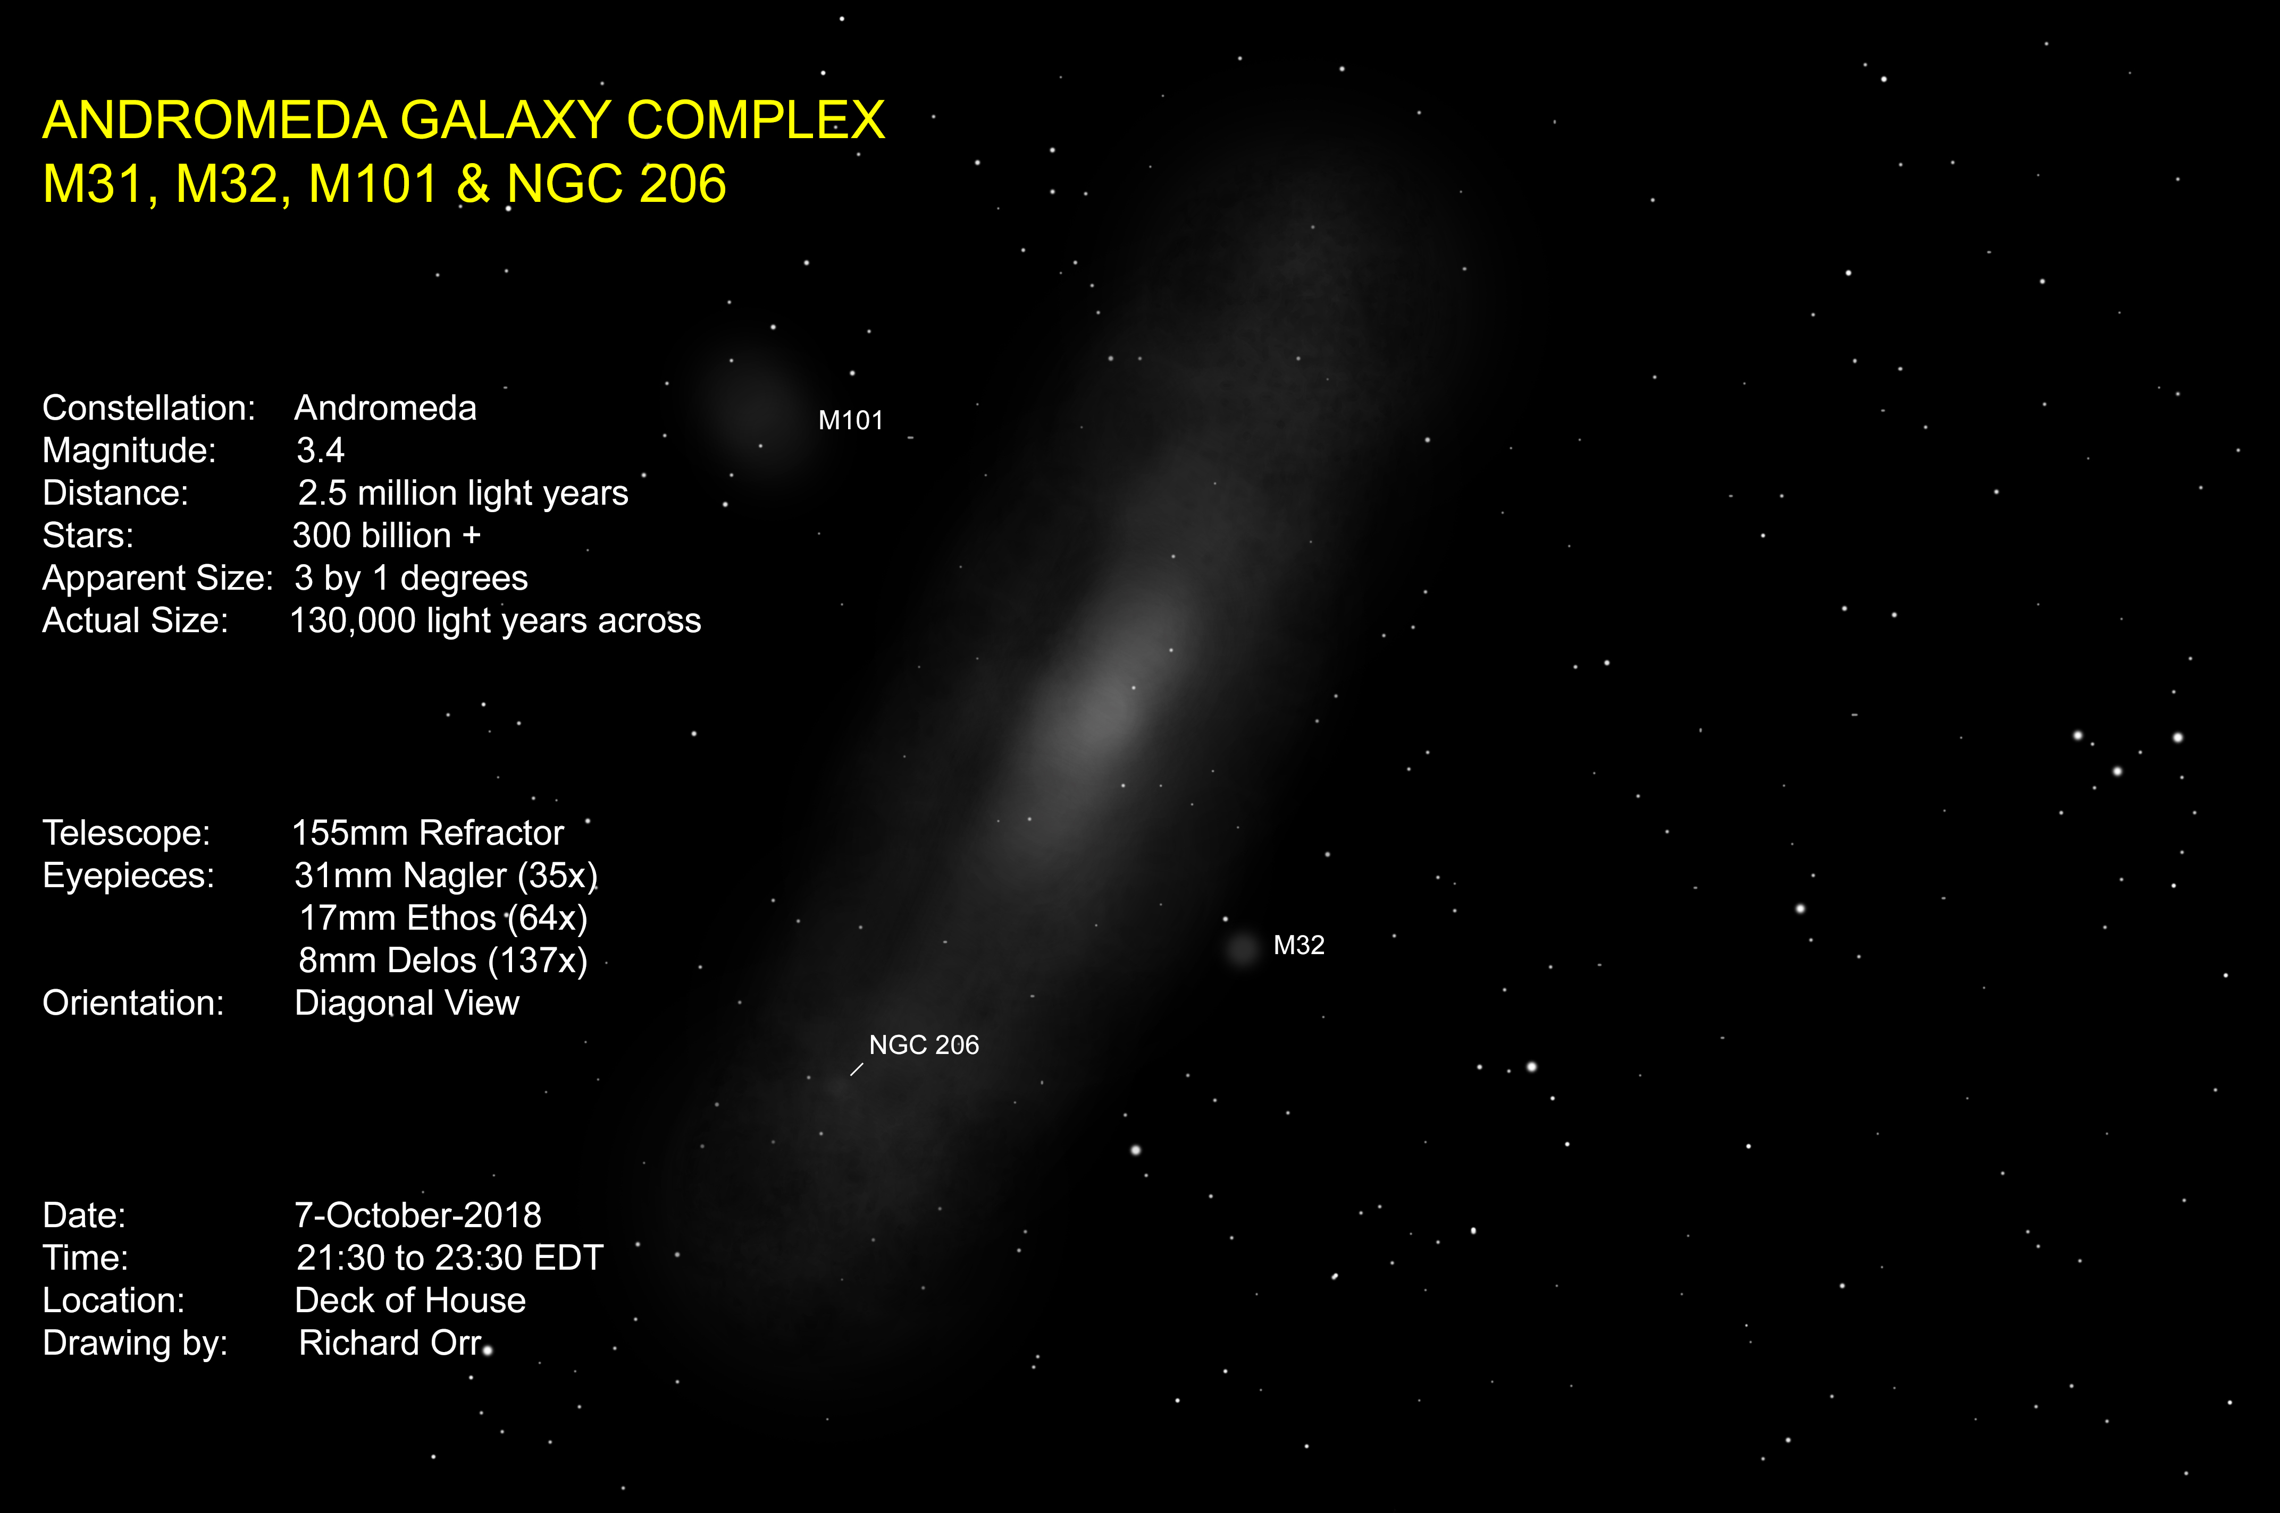

Slide 9
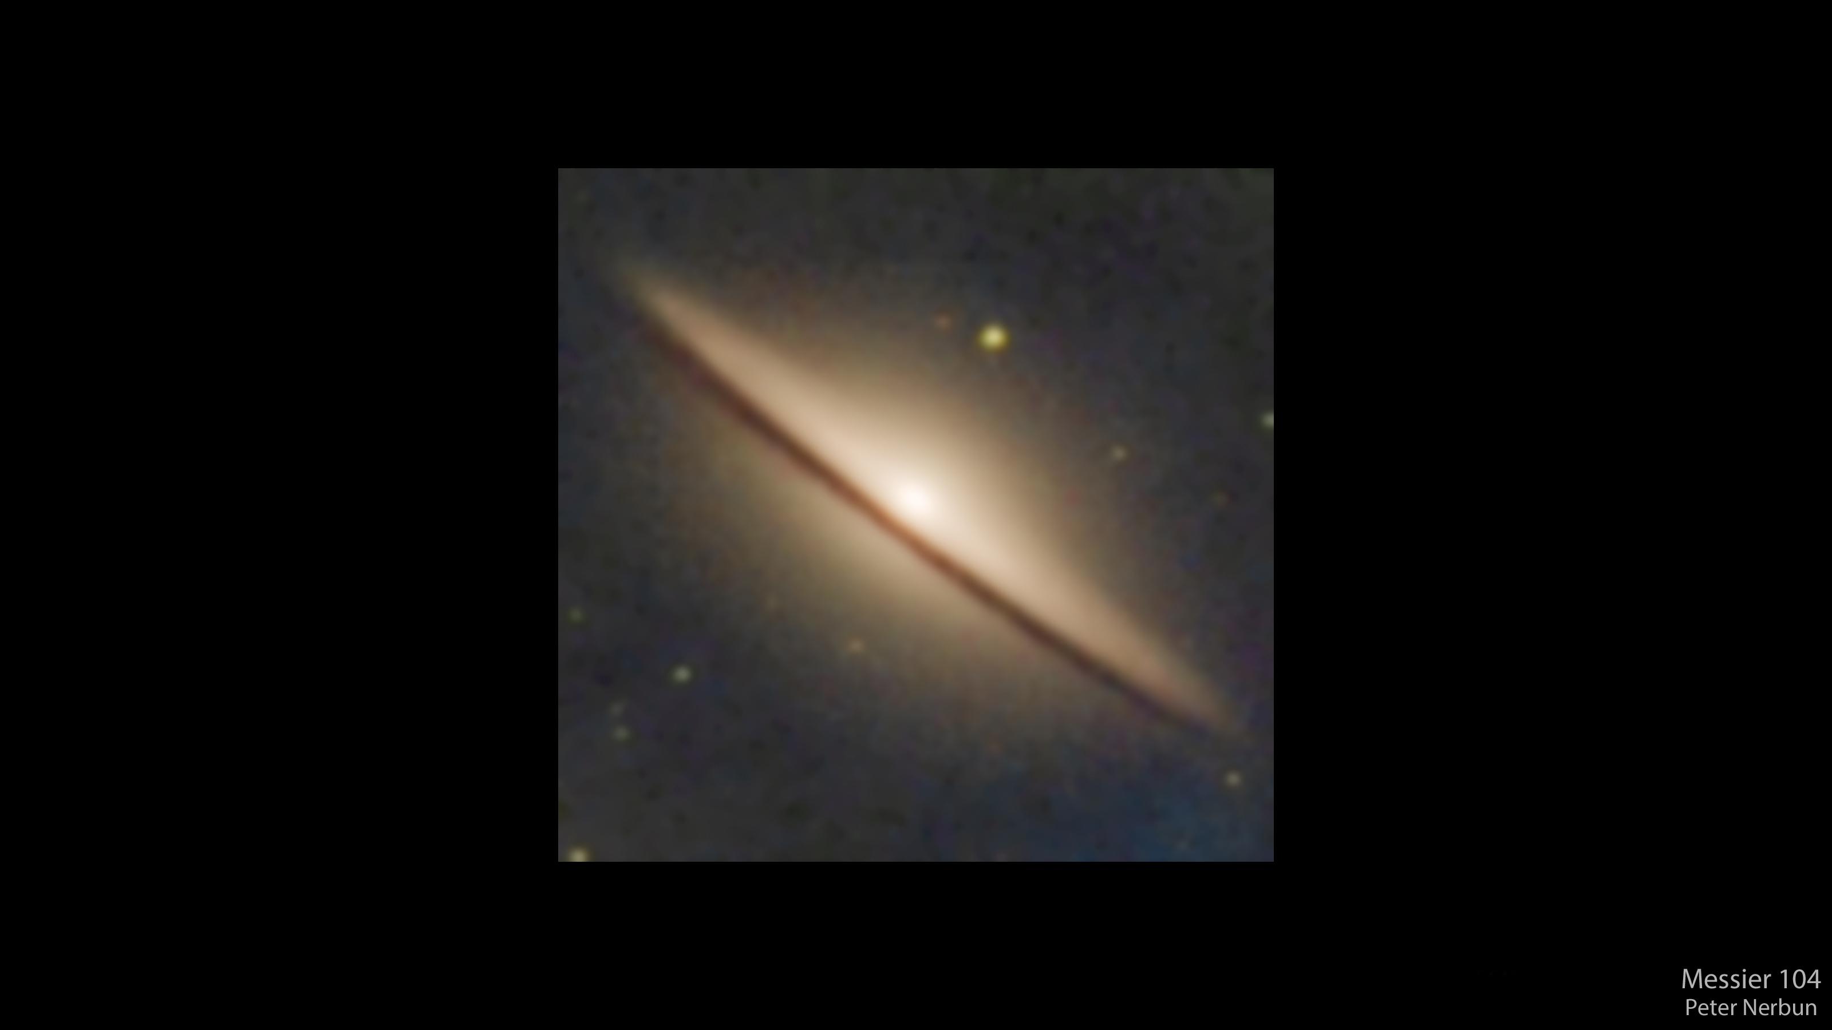

Slide 10
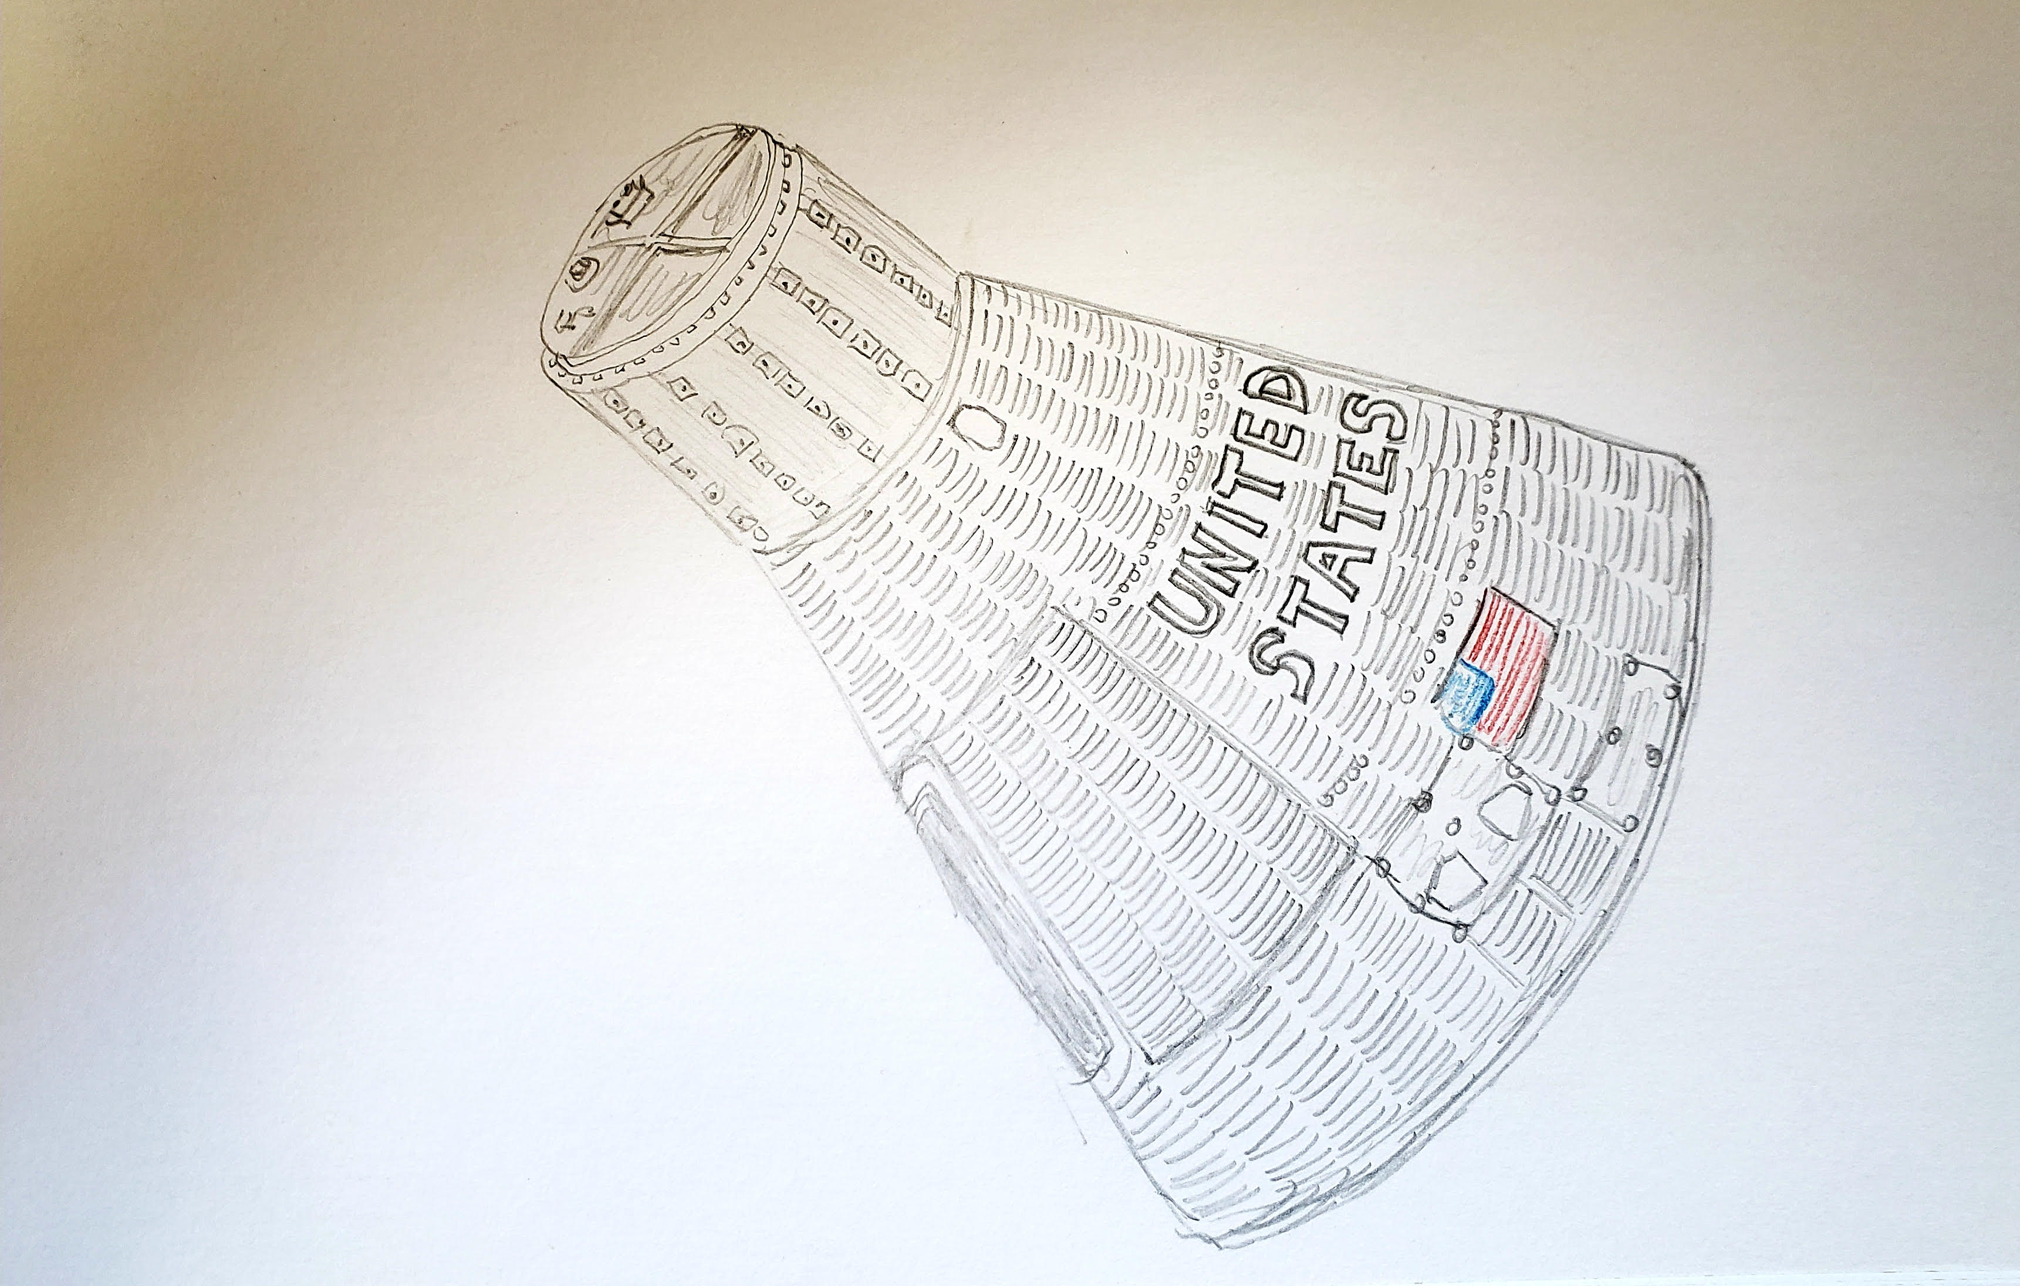
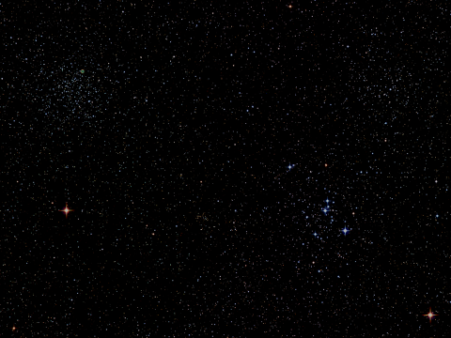
Bob Prokob

Slide 11
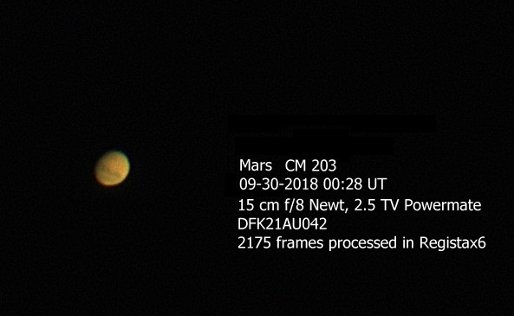
Jim Tomney

Slide 12
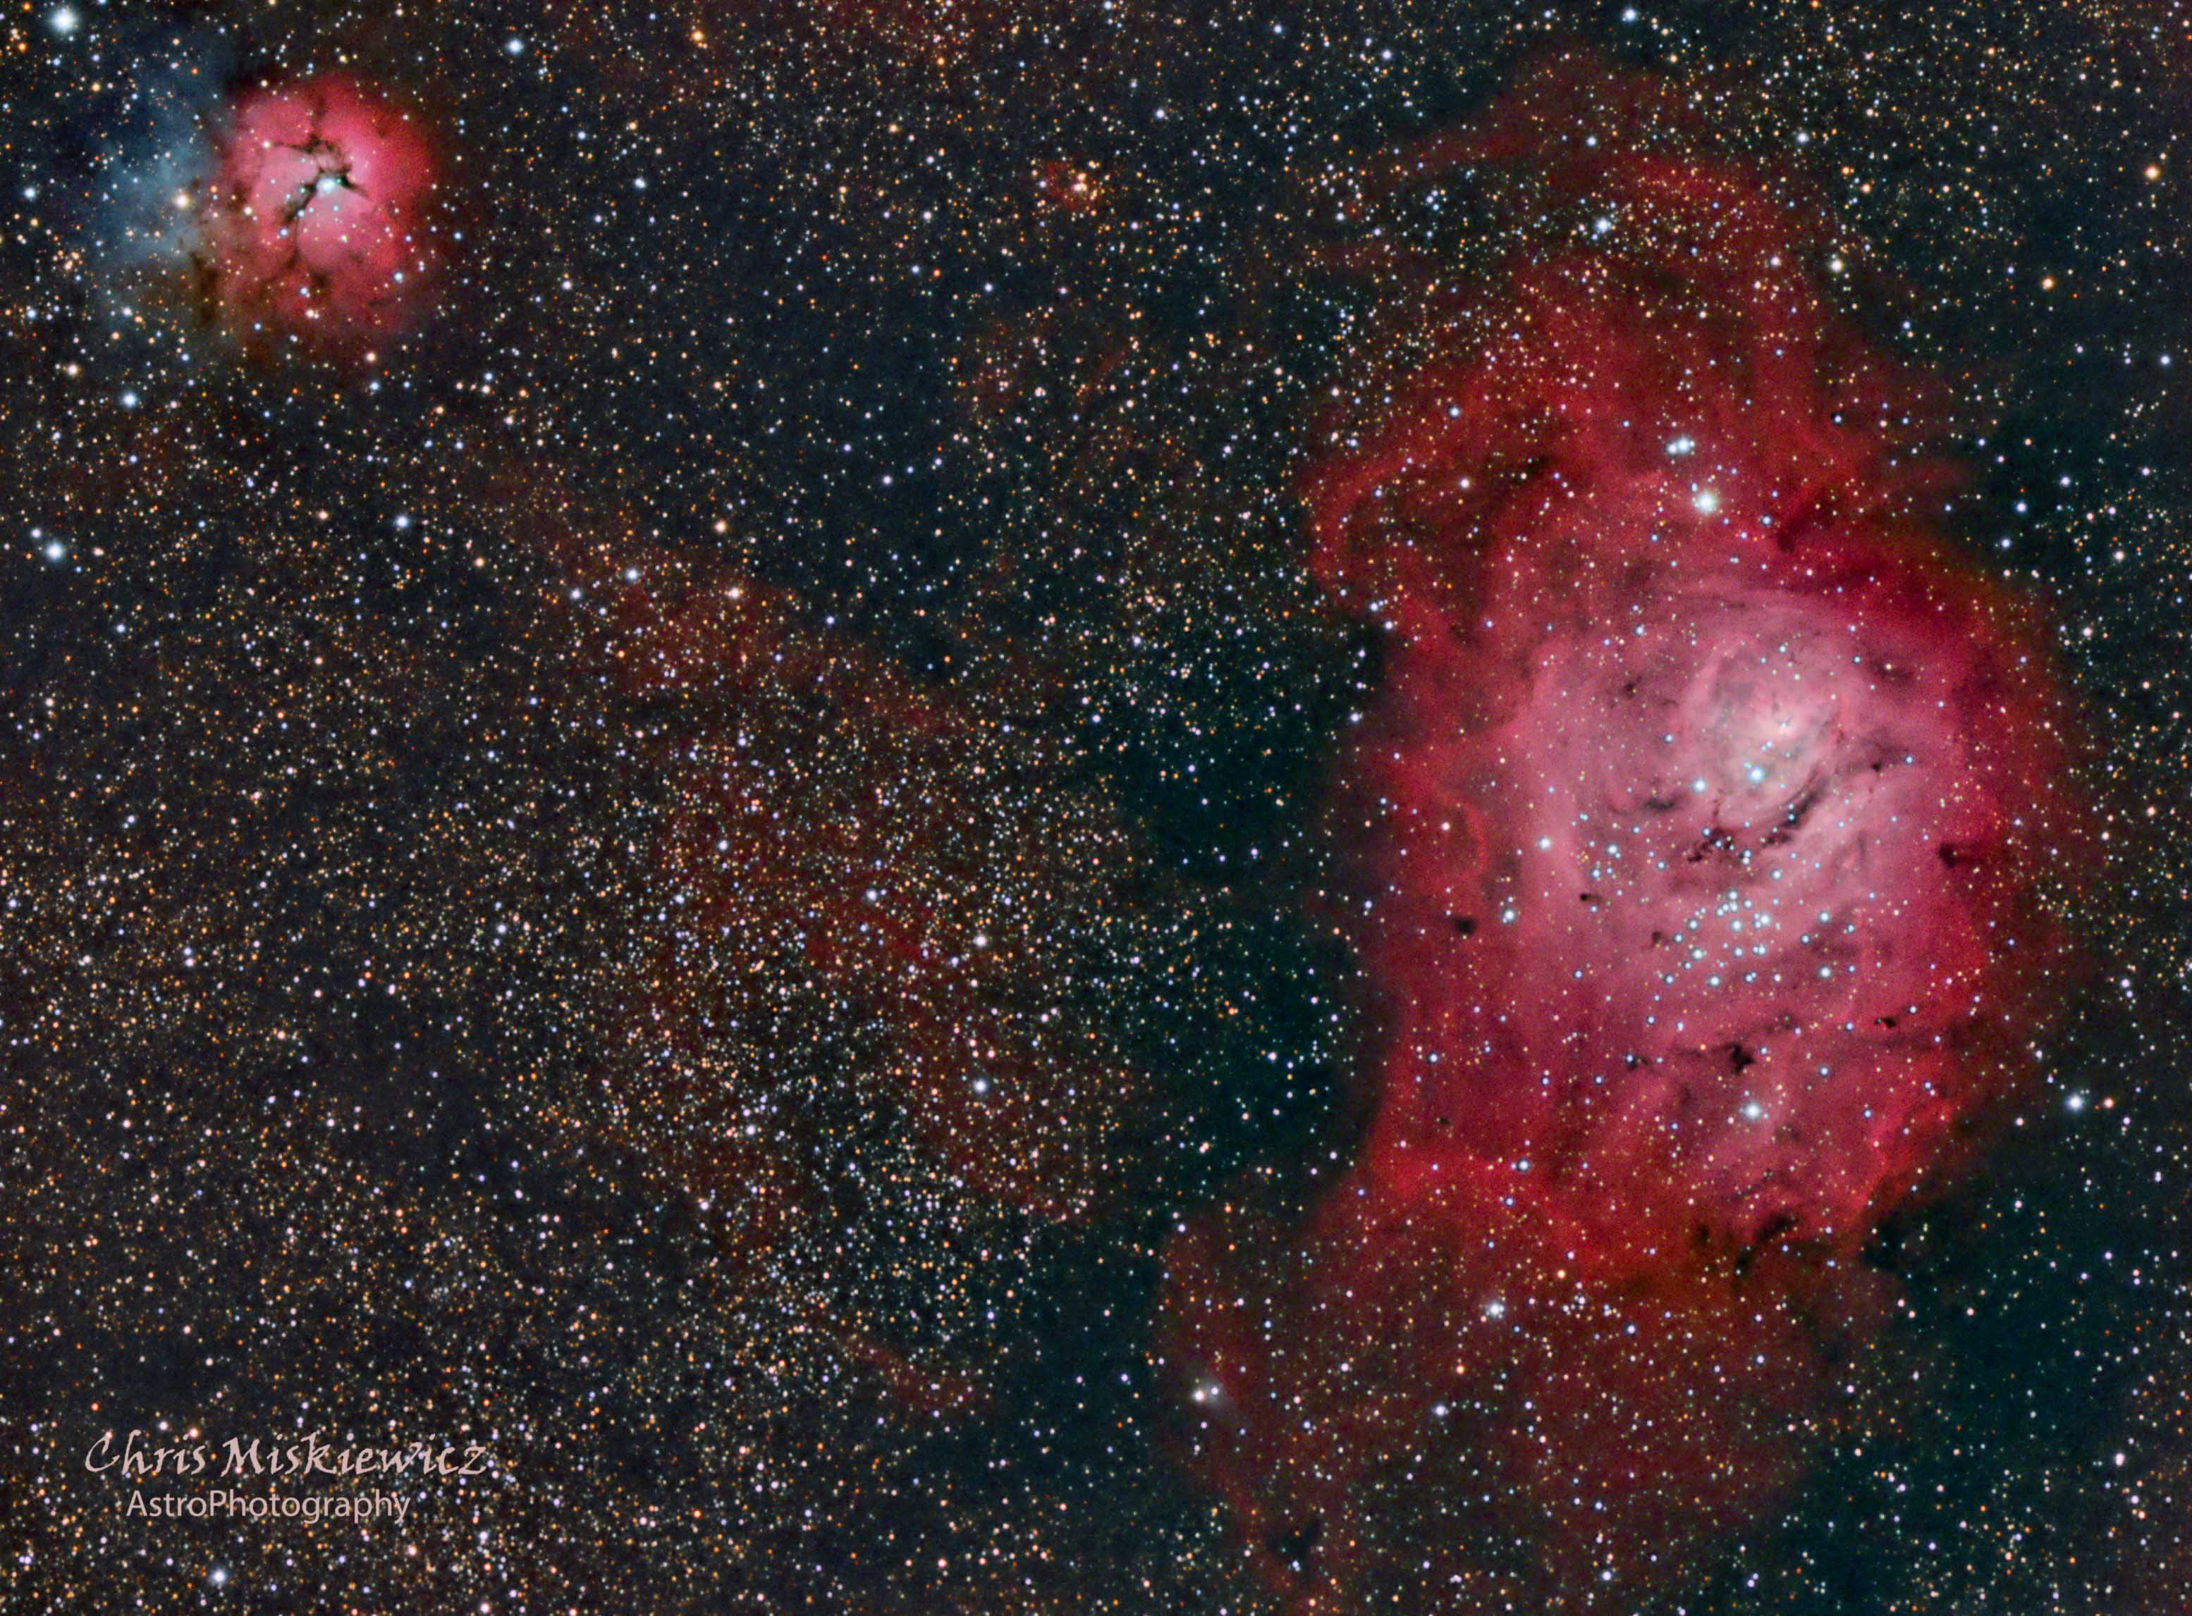

Slide 13
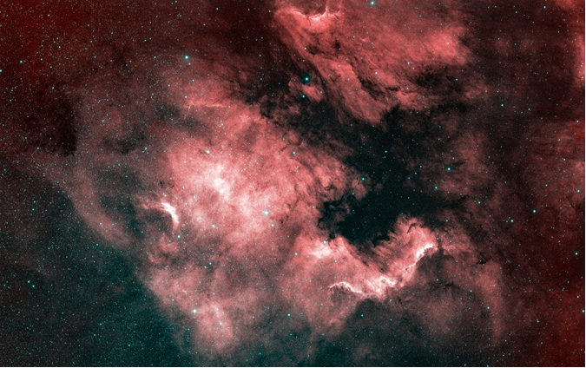
David Illig

Slide 14
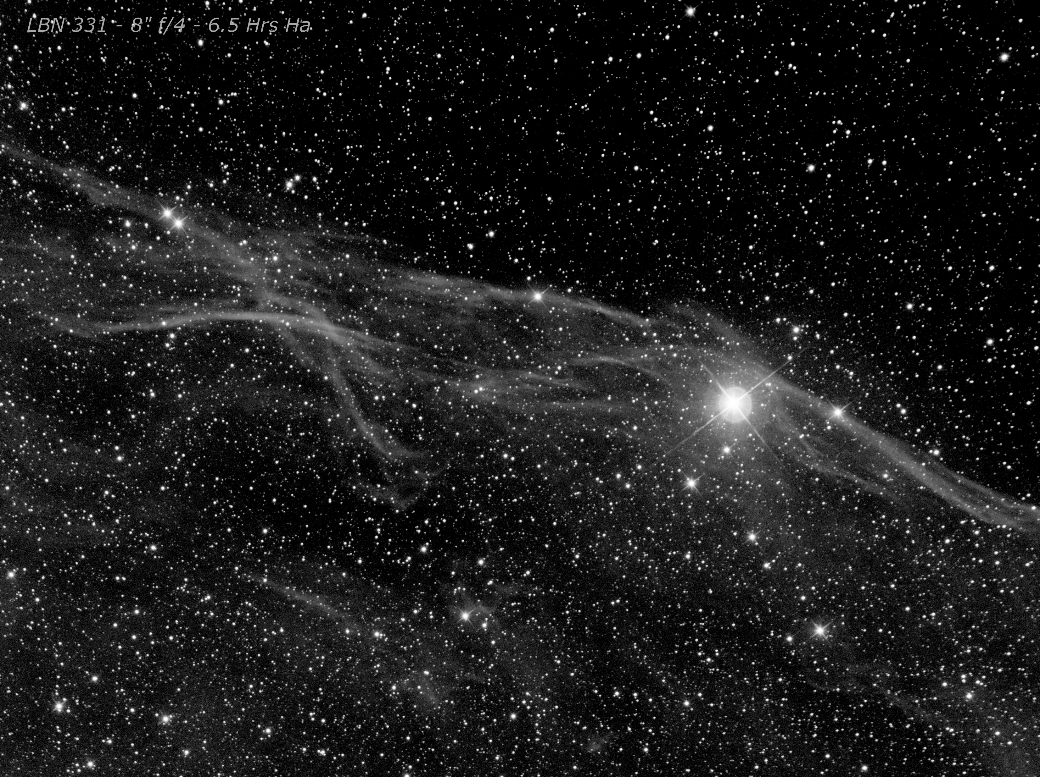
Gene Handler

Slide 15
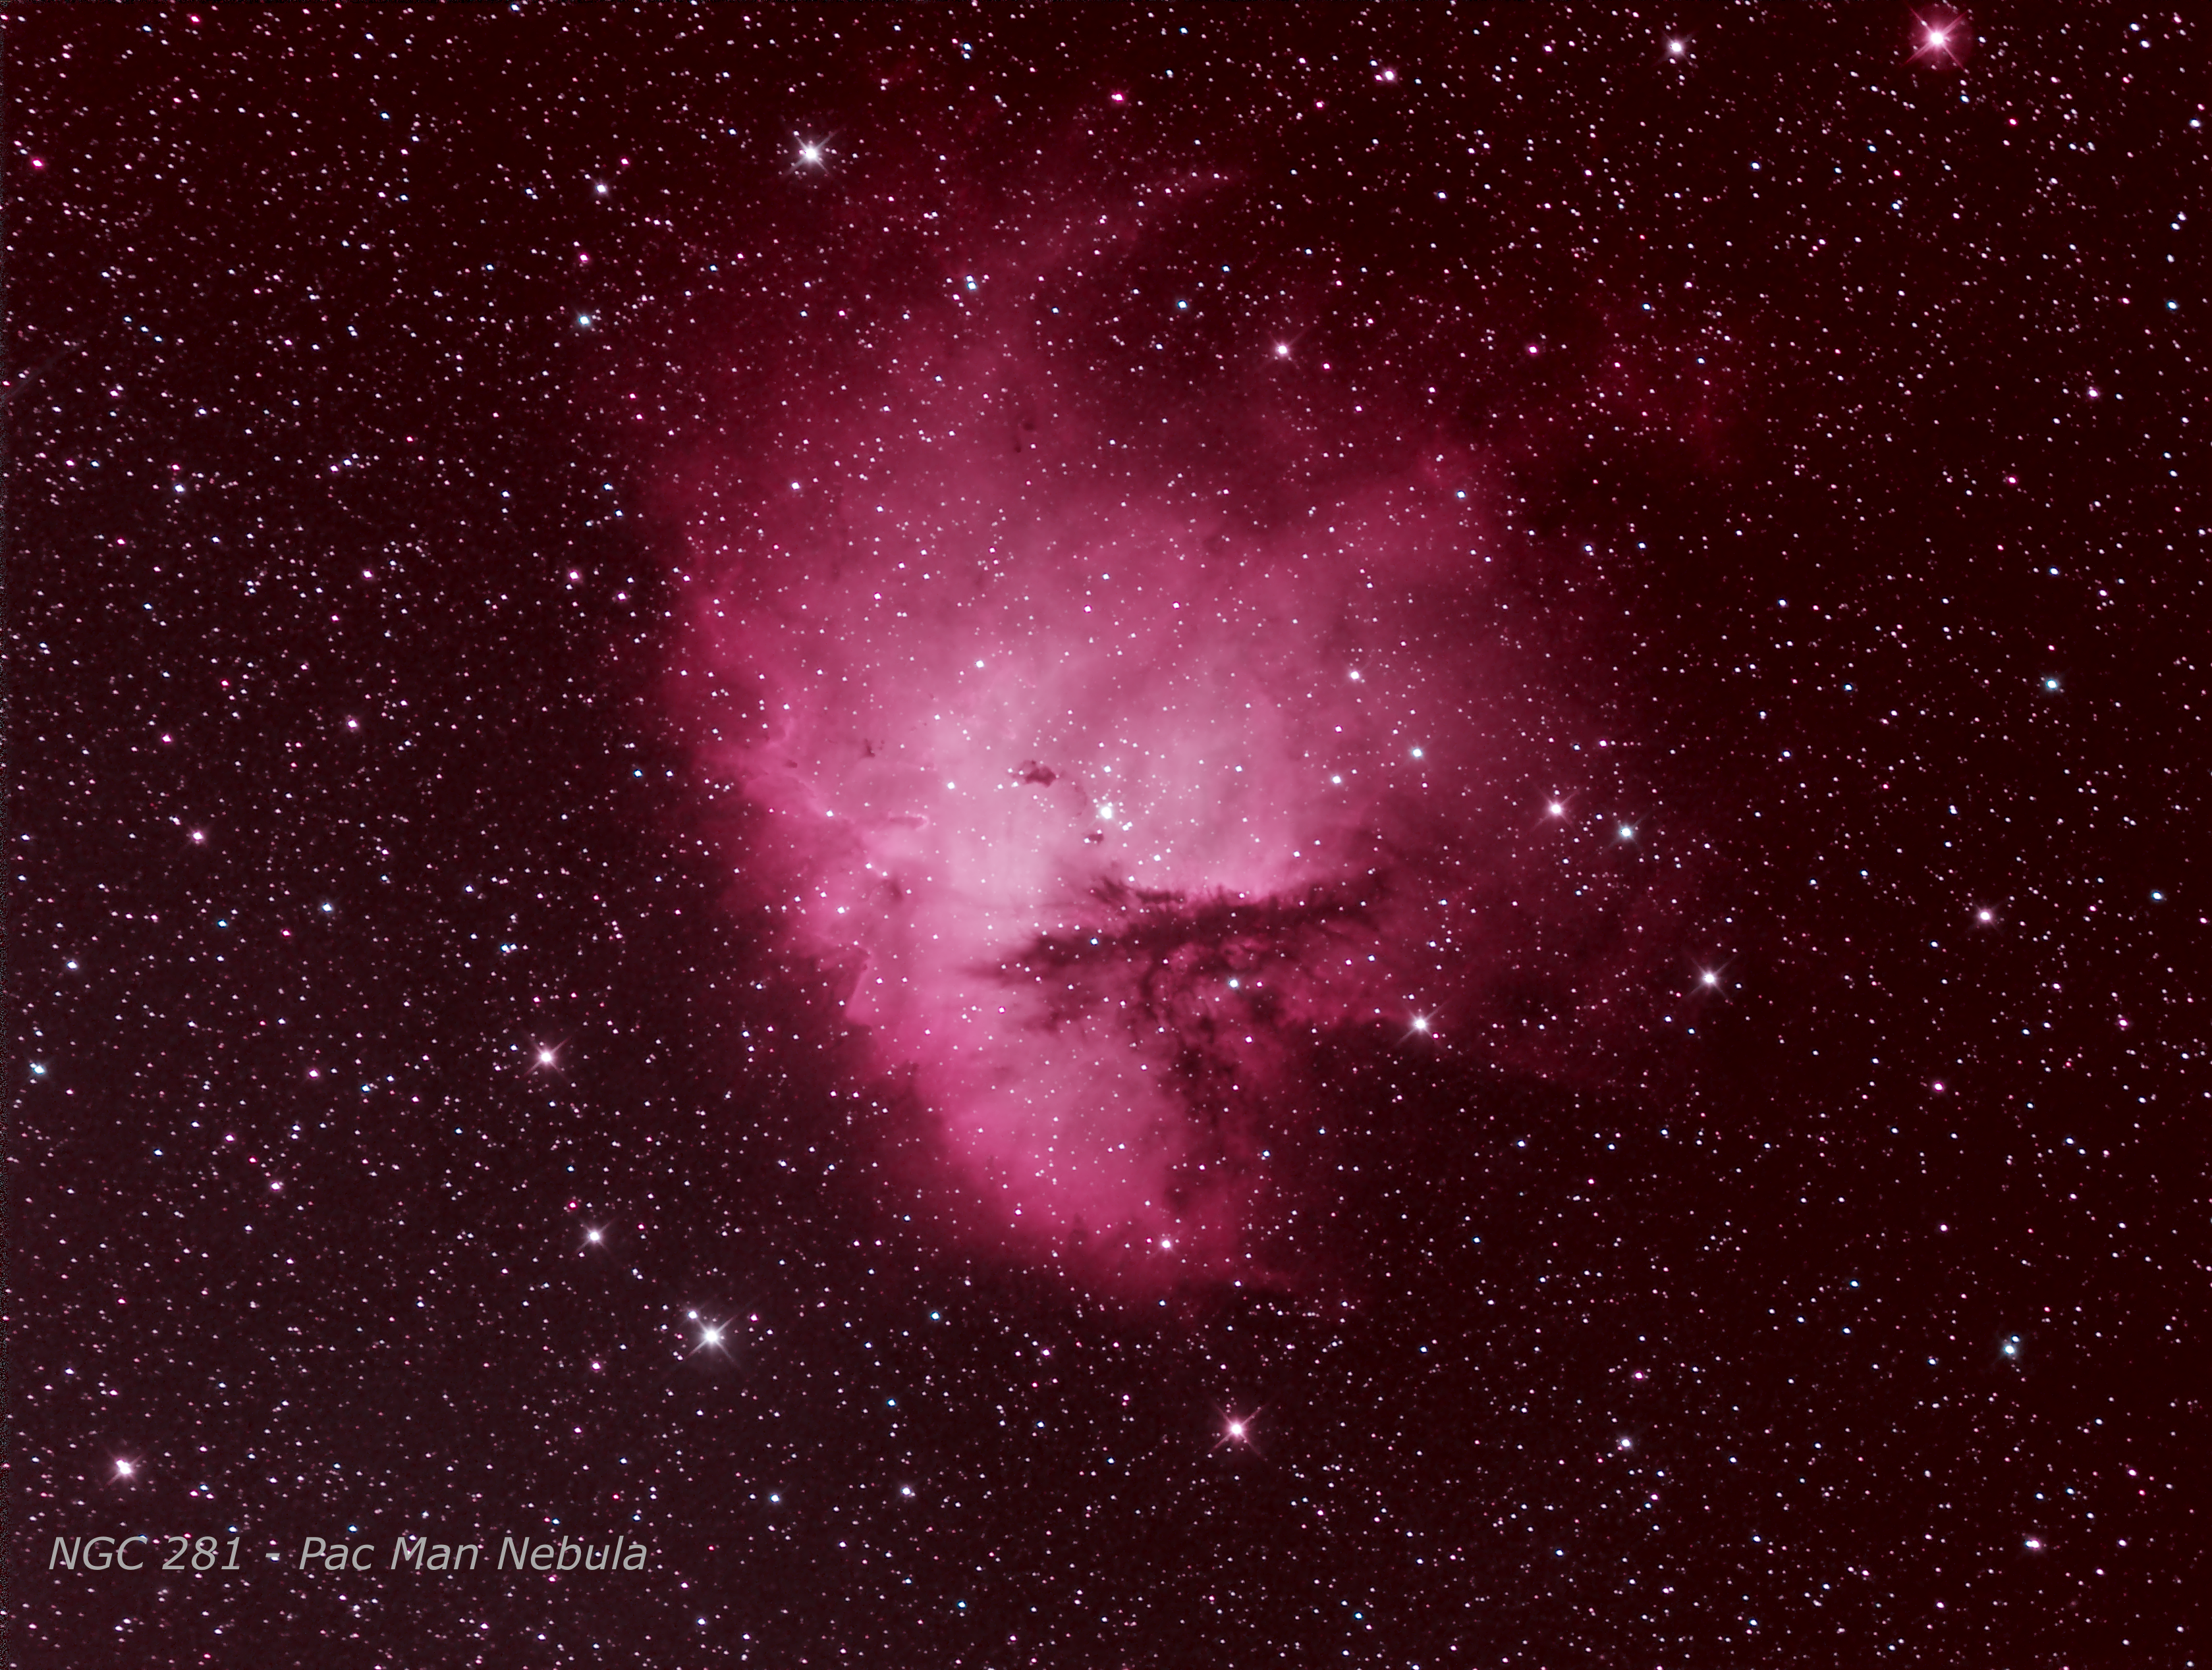


Slide 16
Thank You!
Next month’s meeting is on Thursday, November 15th 2018 at 7 PM
Dr. Albert Holm, Retired
Out of this World Astronomy
Orbital Astronomical Observatory A2

